Slide 2
The wheels on the bus go round and round, round and round, round and round. The wheels on the bus go round and round, all day long.

Slide 3
The wipers on the bus go swish, swish, swish, swish, swish,
swish, swish, swish, swish. The wipers on the bus go swish,
swish, swish, all day long.

Slide 4
The horn on the bus goes beep, beep, beep, beep, beep,
beep, beep, beep, beep. The horn on the bus goes beep,
beep, beep, all day long.

Slide 5
The money on the bus goes clink, clink, clink, clink, clink,
clink, clink, clink, clink. The money on the bus goes clink,
clink, clink, all day long.

Slide 6
DING!
DING!
DING!
DING!
The bell on the bus goes ding, ding, ding, ding, ding,
ding, ding, ding, ding. The bell on the bus goes ding,
ding, ding, all day long.

Slide 7
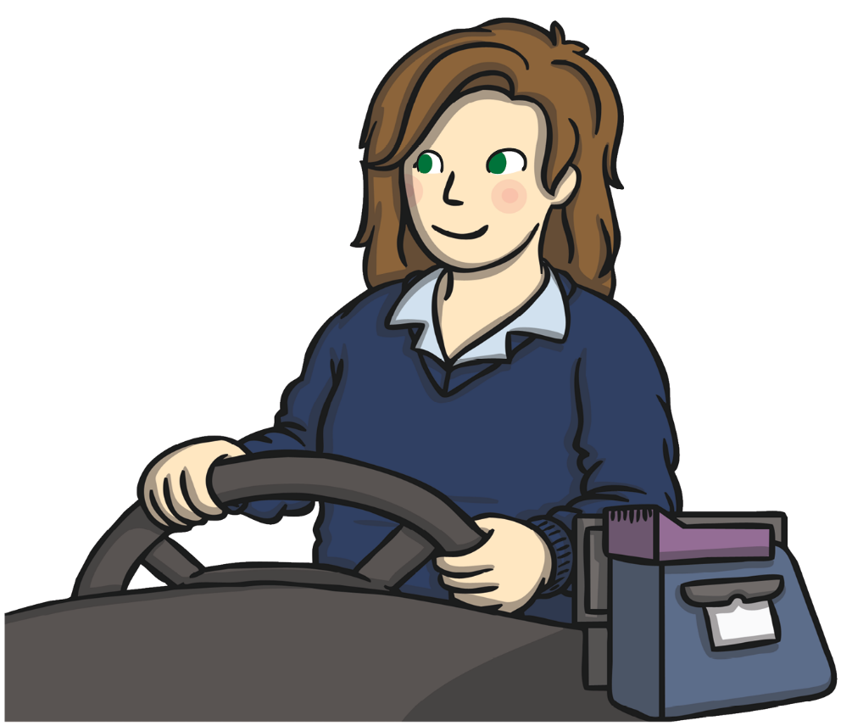
Move
on
back!
Move
on
back!
The driver on the bus says “Move on back, move on
back, move on back.” The driver on the bus says “Move
on back”, all day long.

Slide 8
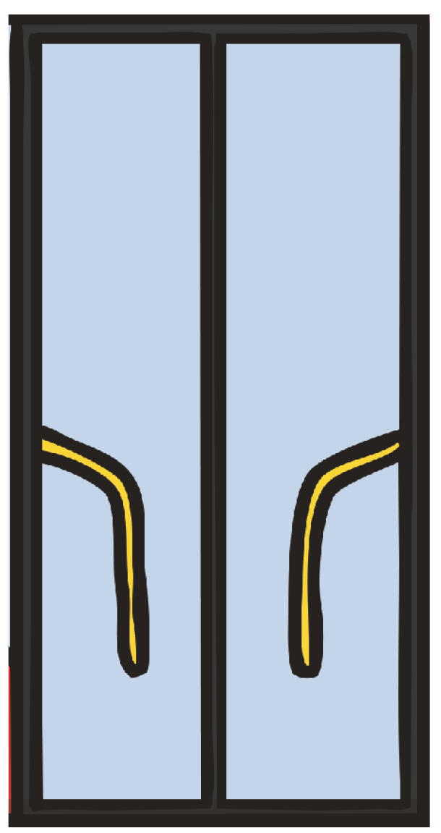
The doors on the bus go open and shut, open and
shut, open and shut. The doors on the bus go open
and shut, all day long.

Slide 9
Hello!
Hello!
Hi!
Hi!
The people on the bus go chitter and chatter, chitter and
chatter, chitter and chatter. The people on the bus go chitter and chatter, all day long.

Slide 10
WAH!
WAH!
WAH!
WAH!
The baby on the bus goes “Wah, wah, wah, wah, wah,
wah, wah, wah, wah.” The baby on the bus goes “Wah,
wah, wah”, all day long.

Slide 11
Shush!
Shush!
Shush!
Shush!
The dad on the bus goes “Shush, shush, shush, shush, shush, shush, shush, shush, shush.” The dad on the bus goes “Shush, shush, shush”, all day long.

Slide 12
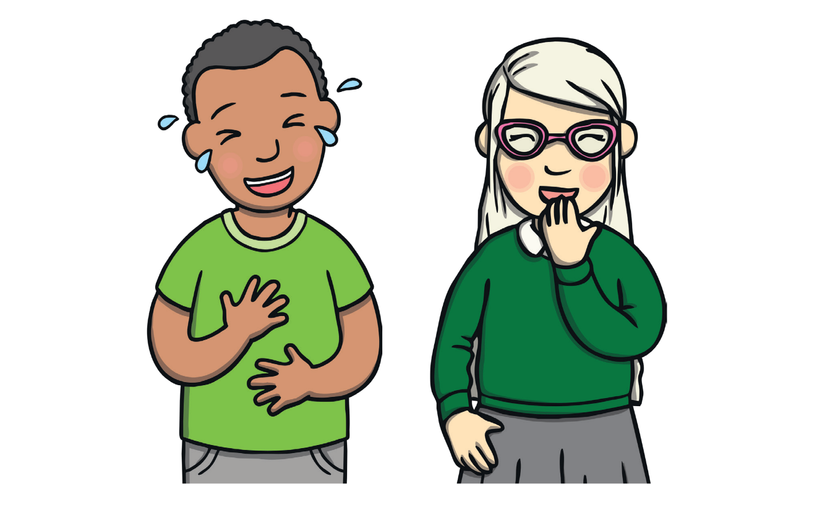
The kids on the bus make too much noise, too much
noise, too much noise! The kids on the bus make too
much noise, all day long.

