Slide 1






Guidance for Video/Audio in PowerPoints
1. Open the folder and copy all the files.
2. Paste the copied files into a new folder.
3. Open the PowerPoint file, enable editing and enter presentation mode (start the slide show).
Please note the embedded audio may not be compatible with early versions of PowerPoint.
You may wish to delete this slide before beginning the presentation.

Slide 3



Oak tree, oak tree, big and tall

Slide 4

How you start as acorn small.

Slide 5
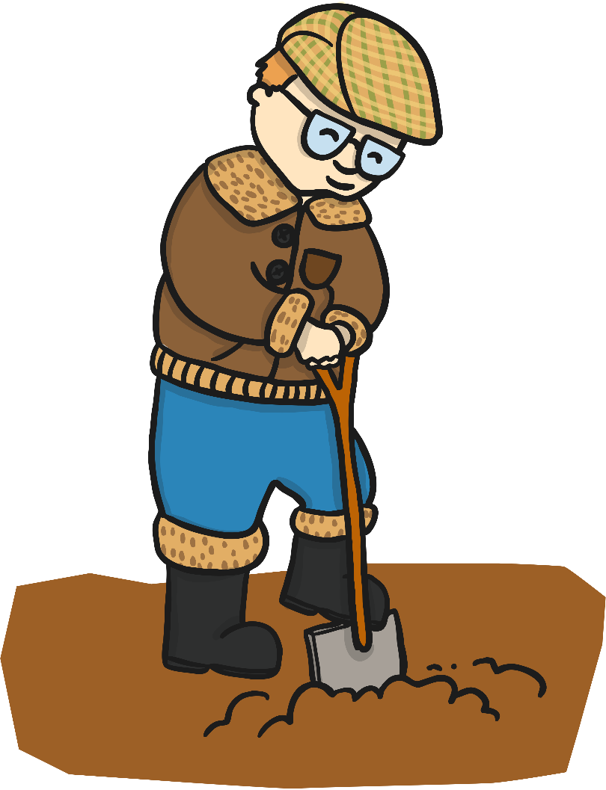
Plant the acorn in the wood,

Slide 6

Time and care the acorn should,

Slide 7
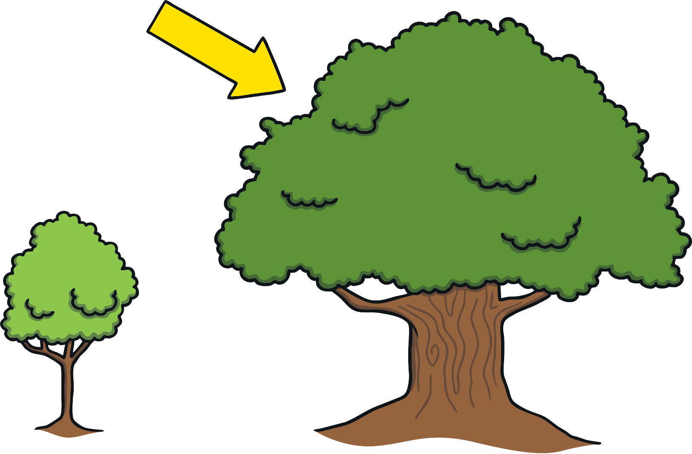
Grow up strong for all to see,

Slide 8
From acorn to tall oak tree.

